Slide 1
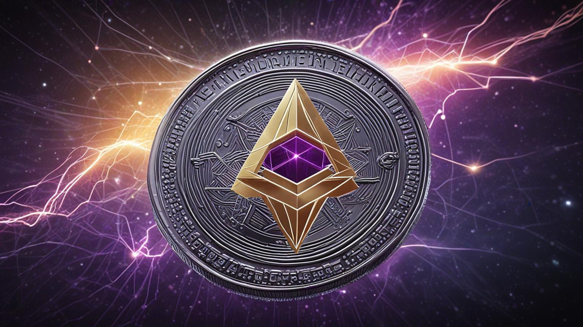

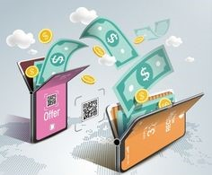
Digital Money Security
Prevents Fraudulent Activities
Protects User Privacy
Ensures Transaction Integrity
Maintains Financial Stability
Builds Trust in Systems

Slide 2


Digital Money Connectivity
Enables Global Transactions
Promotes Financial Inclusion
Facilitates E-commerce Growth
Enhances Payment Efficiency
Supports Digital Innovation

Slide 3
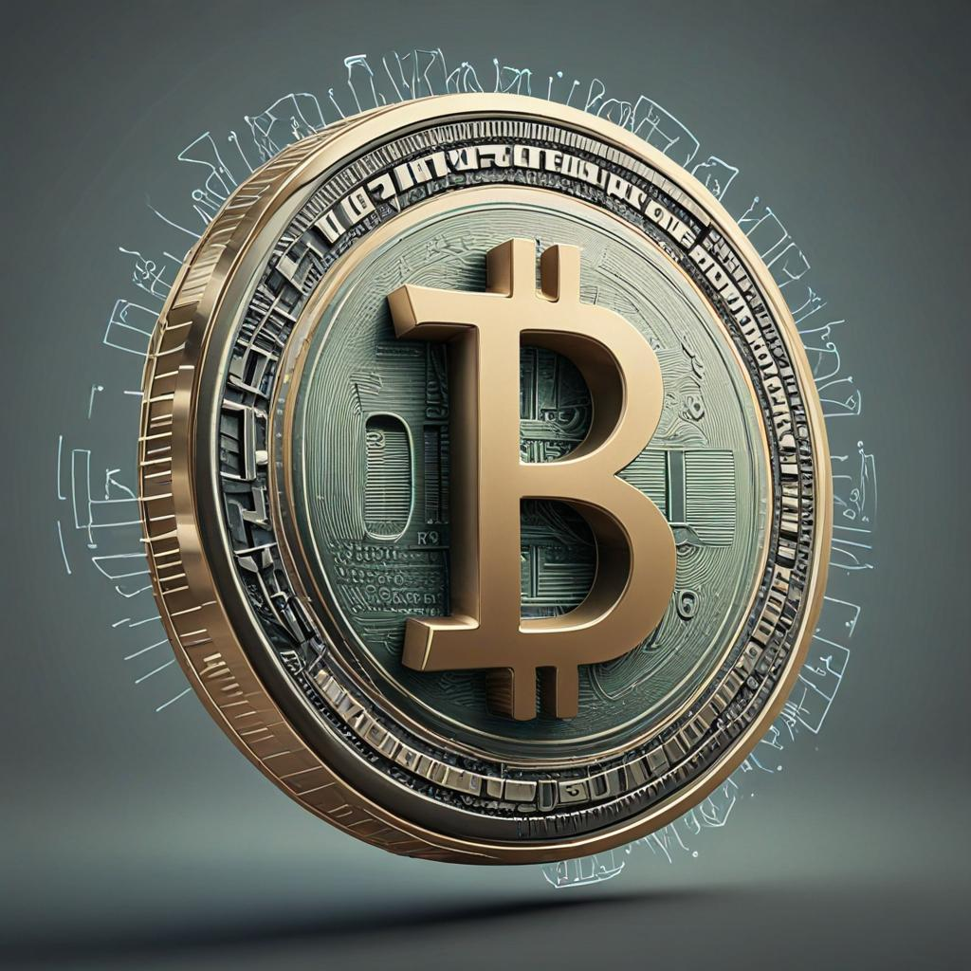
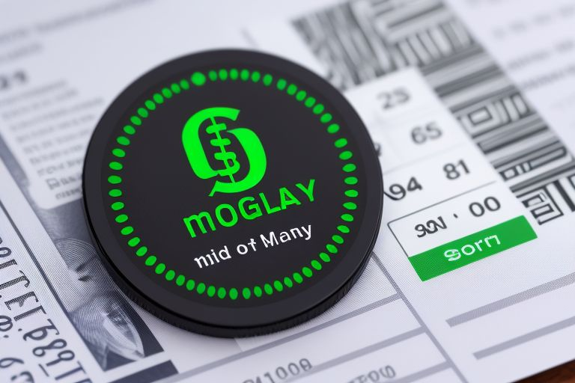
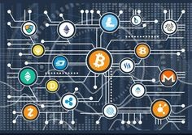
BITCOIN
Decentralized Transactions
Lower Transaction Fees
Global Accessibility
Secure and Transparent
Investment Opportunities

Slide 4
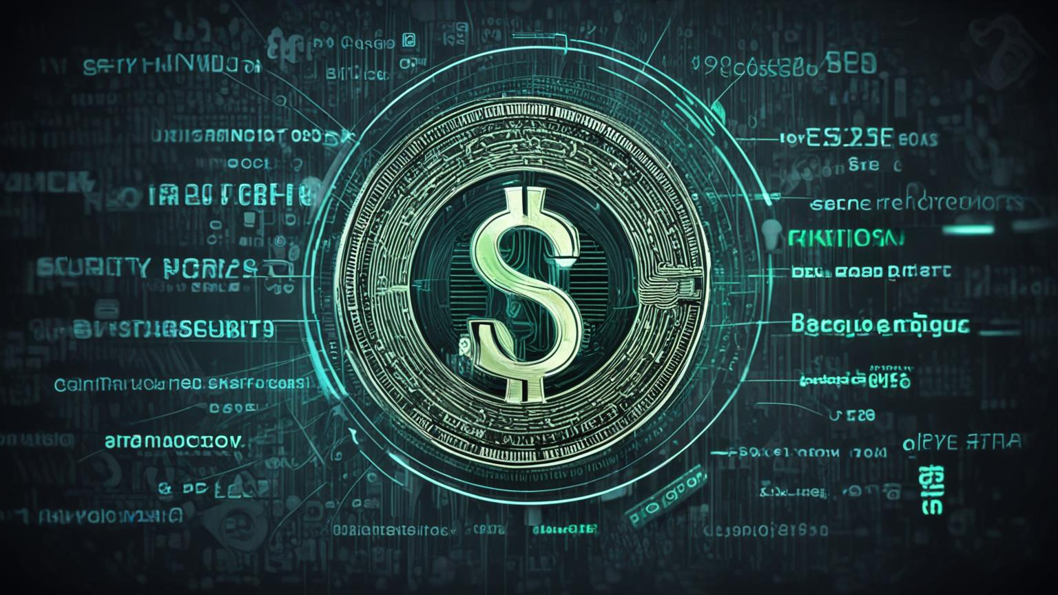
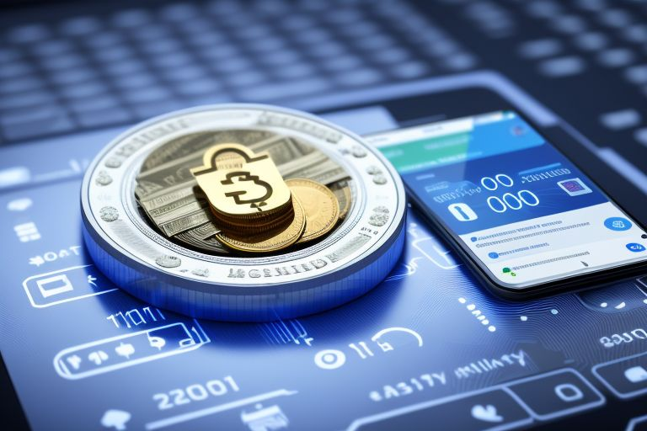
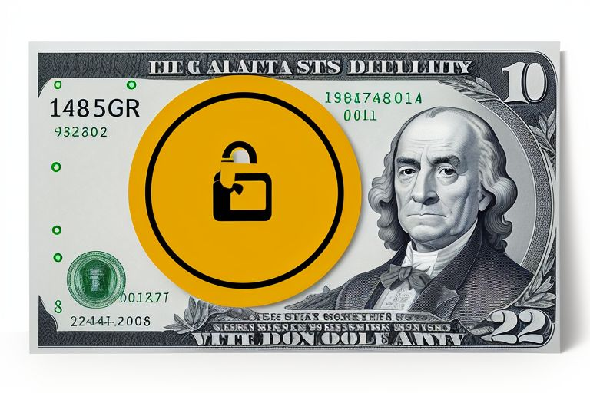
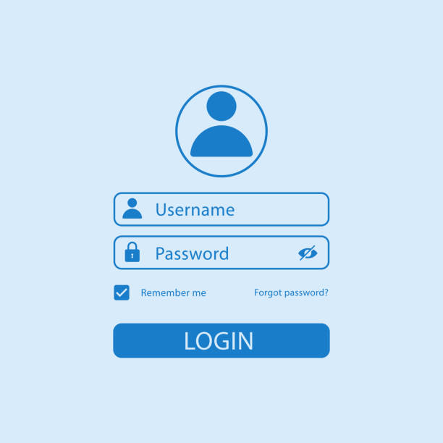
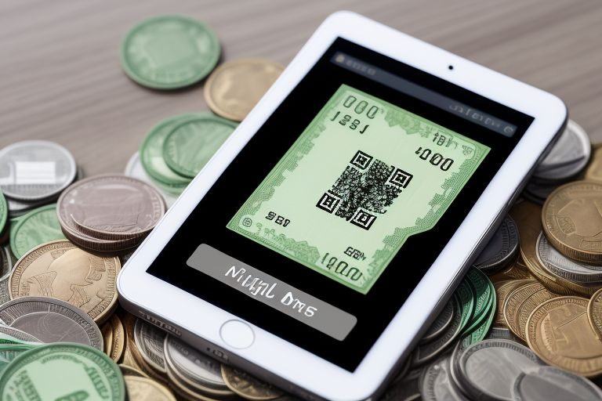
Digital Money Login
Enter Username/Email
Input Password
Verify with OTP
Use Biometric Authentication
Access Dashboard

Slide 5
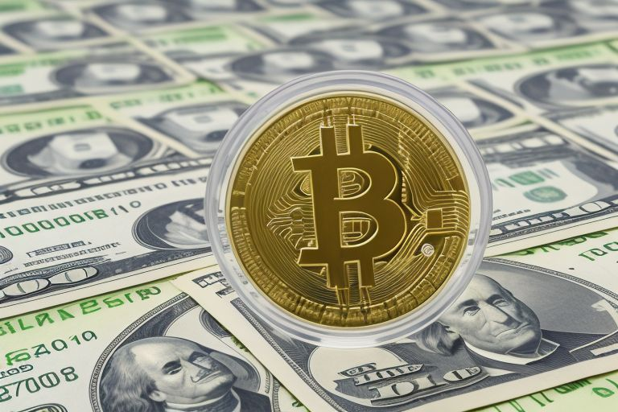
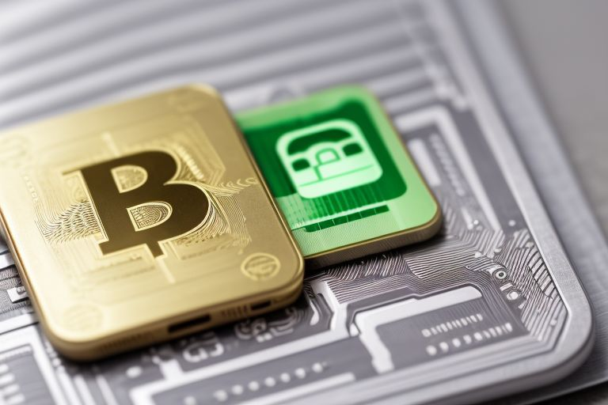

Online Purchases
Peer-to-Peer Transfers
Cross-Border Payments
Investment and Trading
Bill Payments
Microtransactions
E-commerce Integration
Digital Money Use

Slide 6
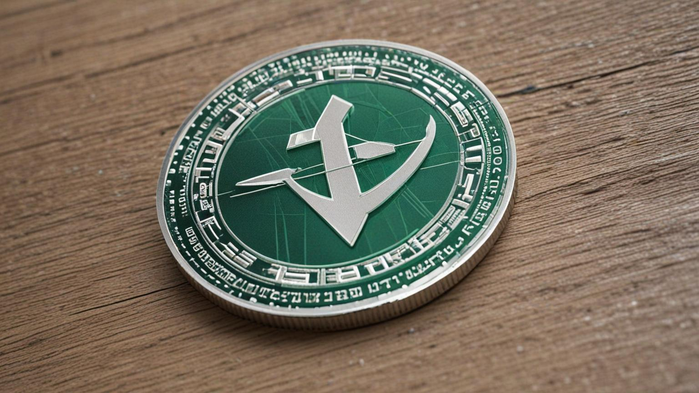
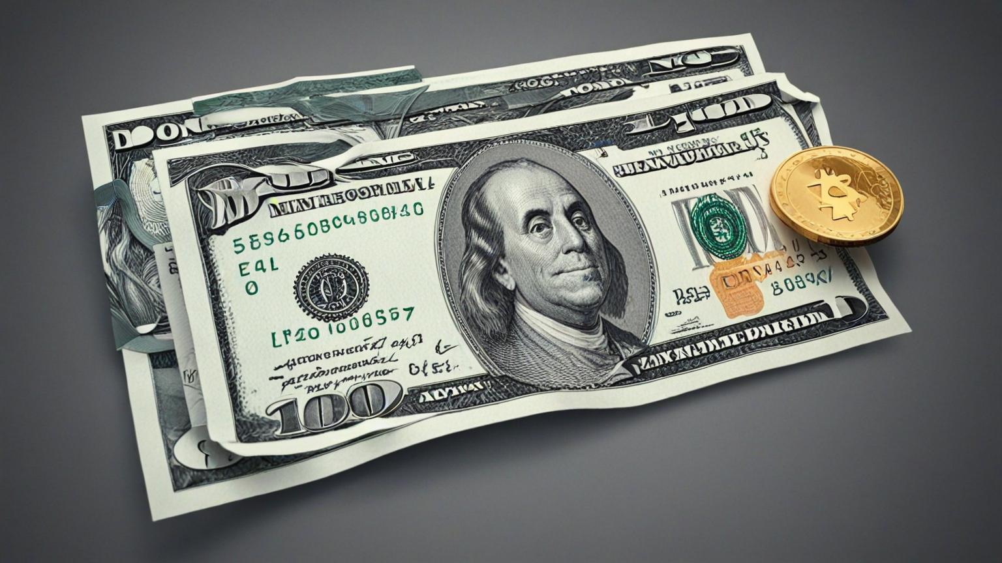

Digital Money
Benefits
Convenience
Speed
Security
Lower
Costs
Accessibility
Transparency

